Slide 1


Increased openness to faith in Australia?
Dr Sam Sterland,
Senior Researcher, NCLS Research

Slide 2
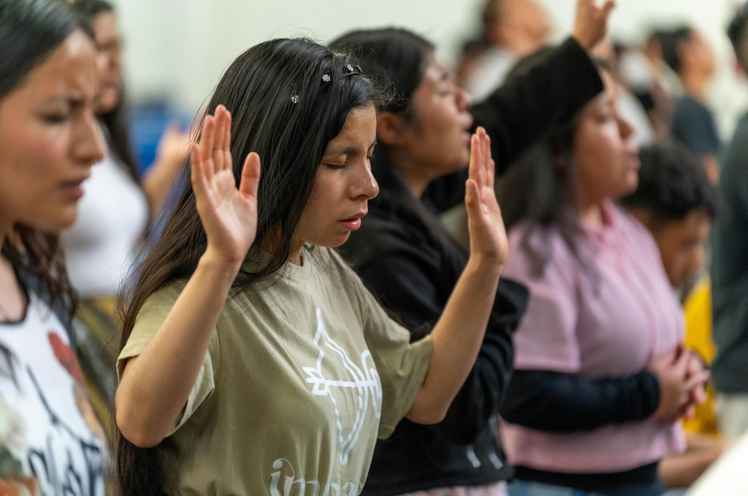

What are we seeing in relation to faith across the Western world?
Renewal?
Resurgence?
Revival?

Slide 3
Revival?
Signals from the UK
Claims that
church attendance decline has halted
growth is now occurring
driven by young adults
more men than women attending
secularisation is declining
The Quiet Revival
Report from The Bible Society, UK

Slide 4
Revival?
International scholars are not convinced
UK
"Is there really a religious revival in England? Why I’m sceptical of a new report"
Emeritus Professor David Voas, University College London

Slide 5
Renewal?
Signals from the USA
Claims that
15-40 year olds now highest attending
more Americans reading the Bible
more men than women attending
Barna Research, USA

Slide 6
Renewal?
International scholars are not convinced
FROM USA - Pew Research
Patchy signs of recovery from pandemic lows seems more plausible
and that seems to be what churches in England are reporting.
We’re getting calls from reporters who want to know about the evidence of a religious revival. They aren’t happy when we tell them we don’t have such evidence.
Conrad Hackett Pew Research (personal correspondence)

Slide 7



What about evidence from Australia?
ACS 2016 to 2025

Slide 8
Australian Community Surveys
NCLS Research aims to provide a picture of social attitudes, religion, spirituality, and wellbeing in Australian communities.
The ACS has been run by NCLS Research in 1998, 2002, 2009, 2016, 2018, 2019, 2020, 2021, 2022, 2024 and 2025.

Slide 9
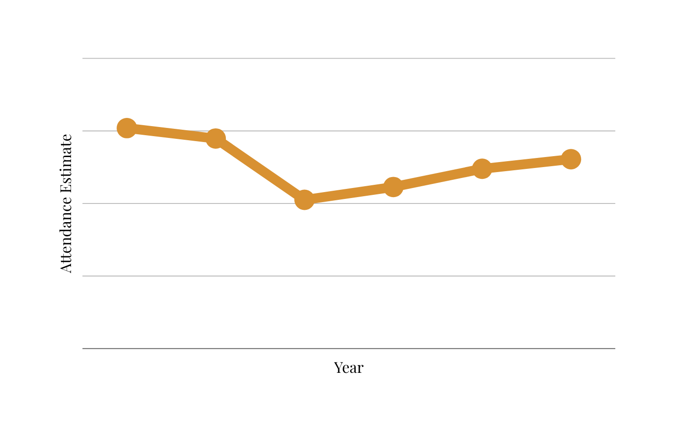
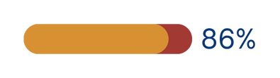

Attendance
estimates
We see patchy recovery in attendance since COVID
Weekly attendance in 2024 was 86% of attendance in 2001
Weekly church attendance estimates: 2001 to 2024
1,519,500
1,447,600
1,305,200
1,239,200
1,113,500
1,025,200
2001
2016
2021
2022
2023
2001
2016
2021
2022
2023
2024
Source: NCLS Churches Estimates of Attendance Database. Based on estimates collected from 21 denominations through National Church Life Surveys and also provided by denominational/regional partners.

Slide 10
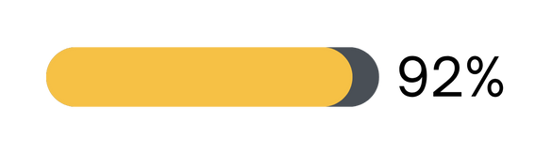
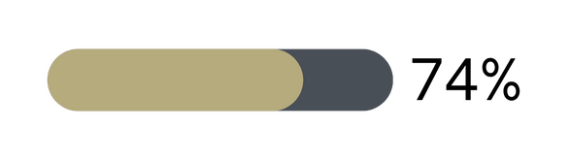
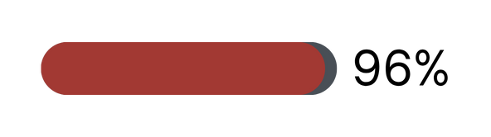

Attendance
estimates
The recovery in attendance has varied across denominations since COVID
Weekly church attendance estimates: 2001 to 2024
Catholic
Mainstream
Pentecostal
Other Protestant
Source: NCLS Churches Estimates of Attendance Database. Based on estimates collected from 21 denominations through National Church Life Surveys and also provided by denominational/regional partners.

Slide 11


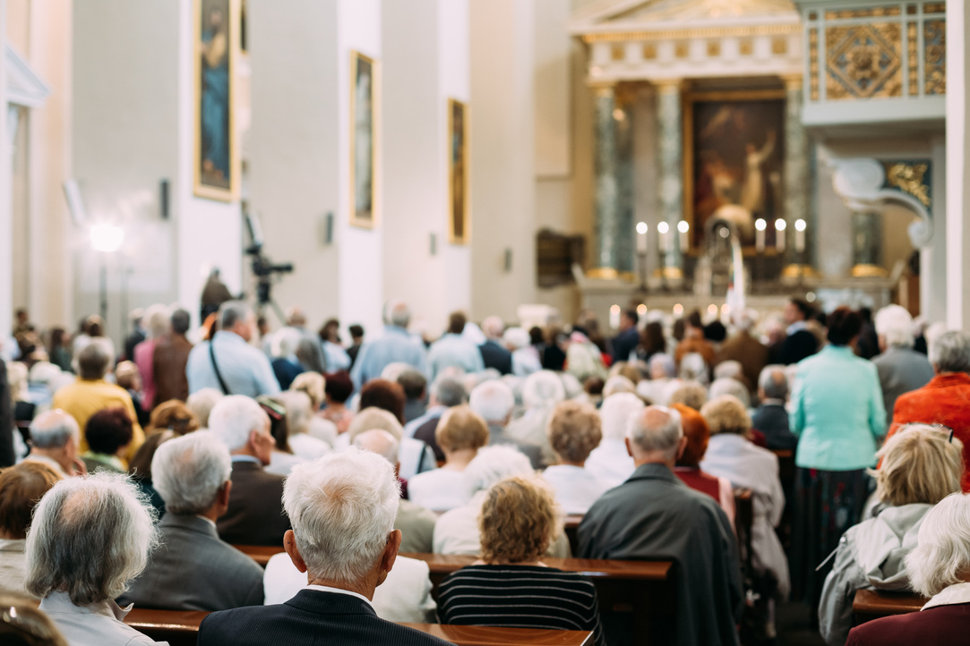

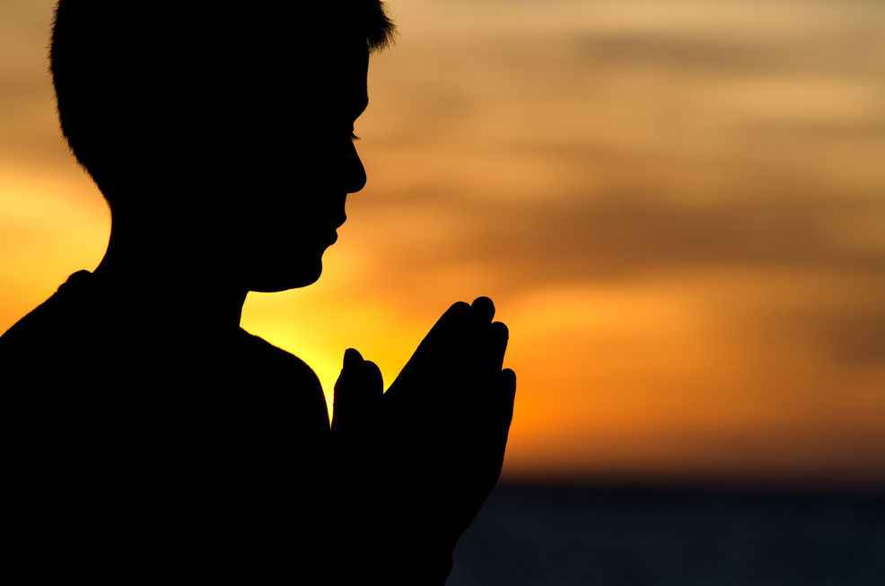

Other indicators of religiousness have seen little change
over time
A person’s religiousness or spirituality has multiple dimensions.

Slide 12
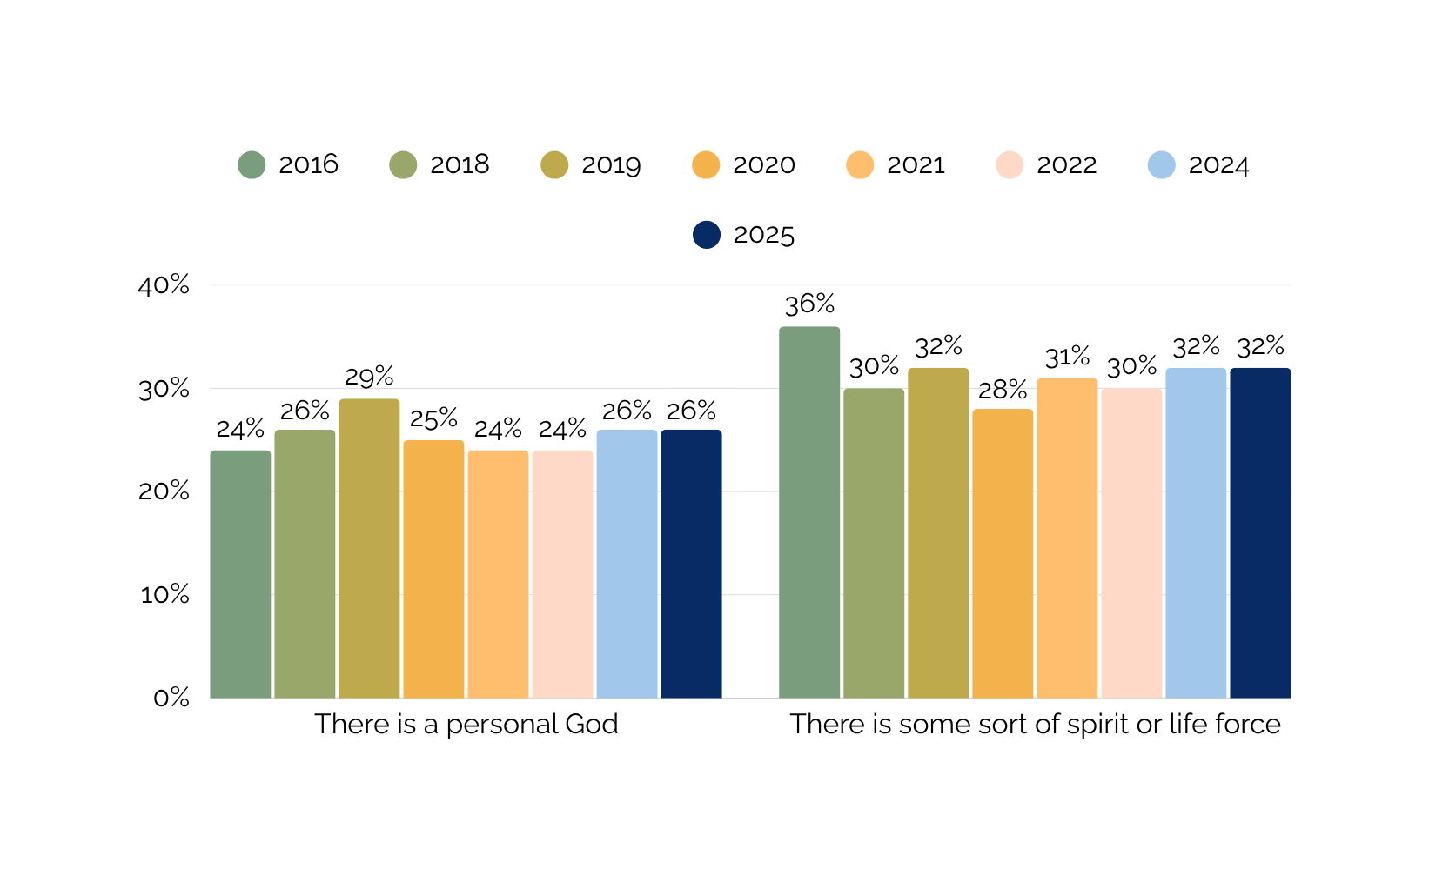
E.g. 1
Belief in God
Which of these statements comes closest to your belief about God?
2016 - 2024 Australian Community Survey by NCLS Research

Slide 13
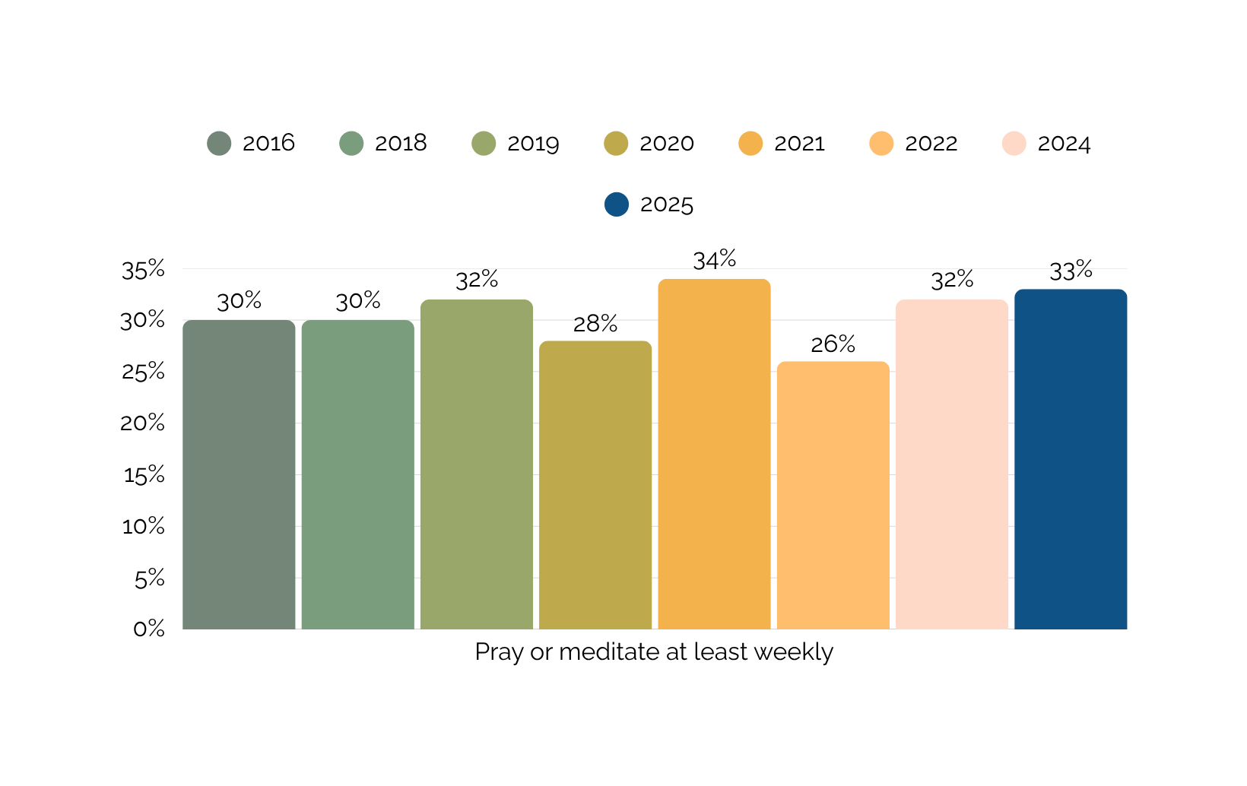
Private religious practice
How often do you pray or meditate?
2016 - 2024 Australian Community Survey by NCLS Research

Slide 14
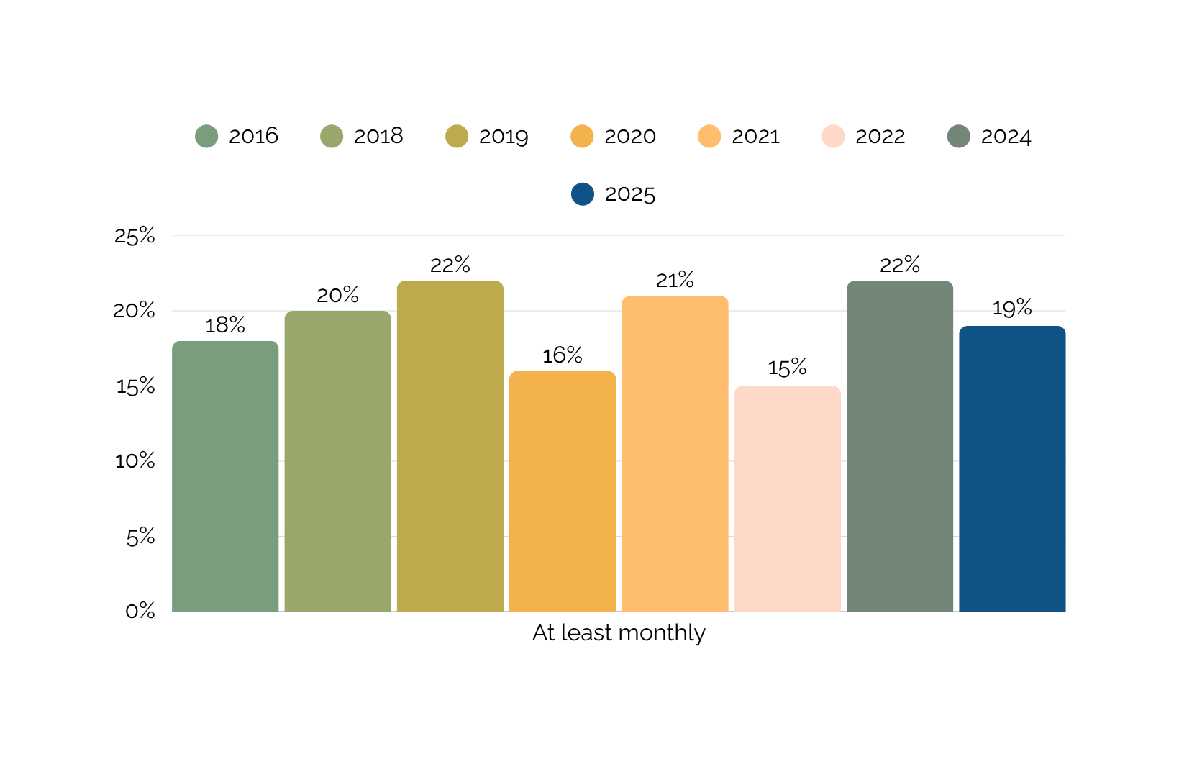
Religious service attendance
Frequent religious service attendance (at least monthly)
2016 - 2025 Australian Community Survey by NCLS Research

Slide 15
While there are not strong patterns over the past decade, some indicators show possible signs of an increased openness in recent years.

Slide 16
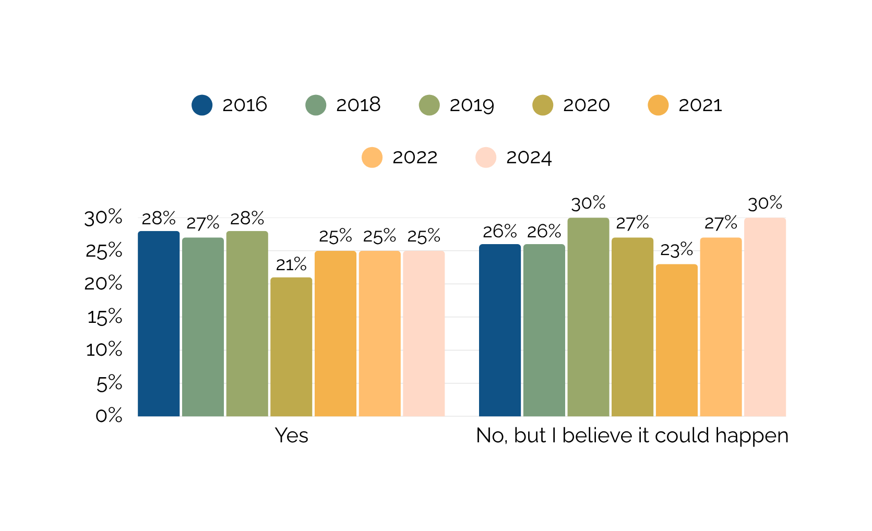

E.g. Experience
Have you ever had a mystical or supernatural experience, either positive or negative, about which you have no doubts it was real?
2016 - 2024 Australian Community Survey by NCLS Research

Slide 17
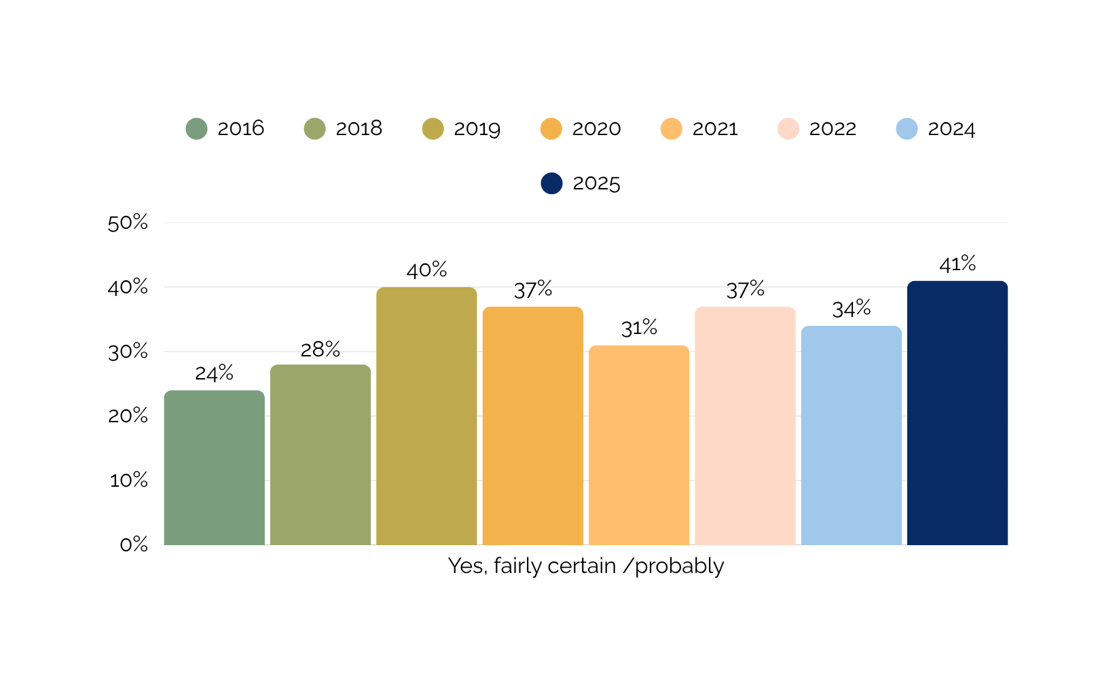
Open to invitation
Apart from such special occasions as weddings, funerals, etc., would you go to a Christian church service if invited by close friends or family?
2016 - 2024 Australian Community Survey by NCLS Research

Slide 18
Generational differences matter.
Some of the Gen Z cohort are curious
Australian Community Surveys

Slide 19
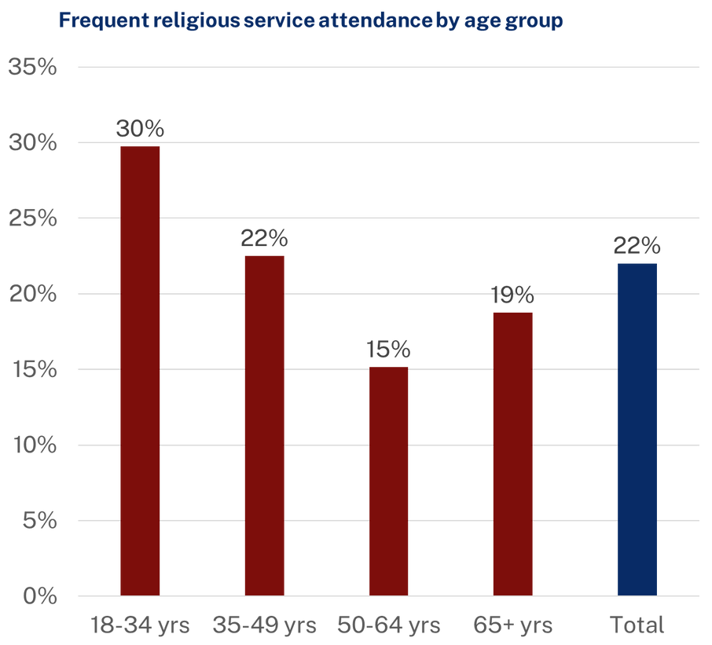

Generations differ
e.g. When reporting their attendance at services (at least monthly)
  Gen Z (young adults) are highest
  Gen X are lowest
2024 Australian Community Survey by NCLS Research

Slide 20
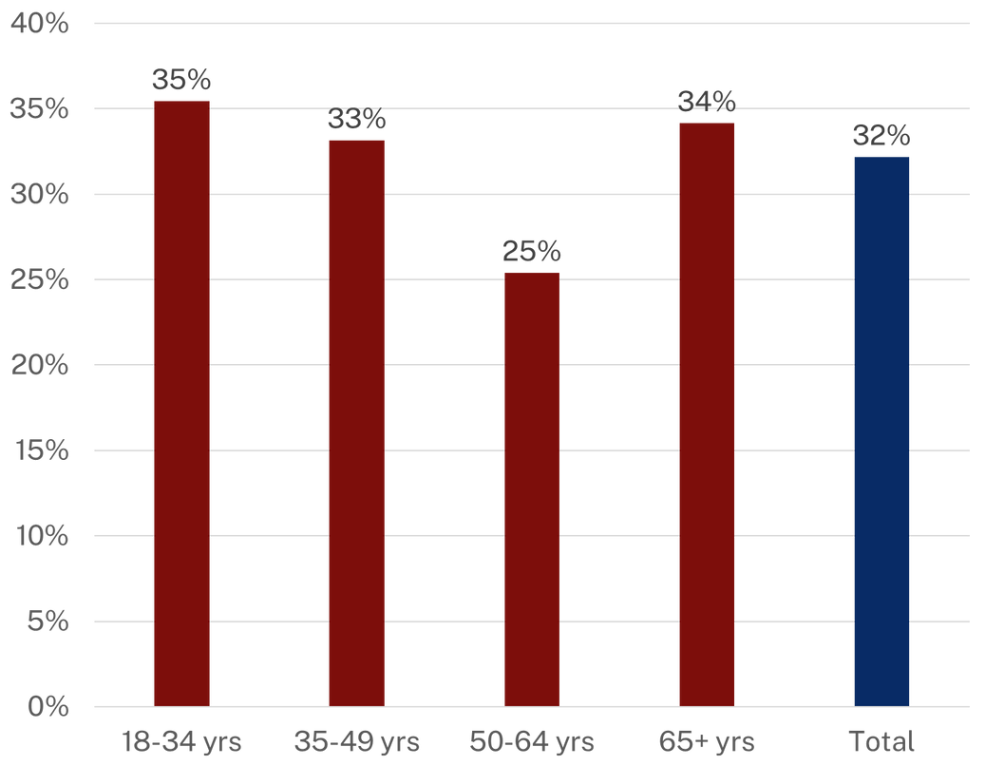
Generations differ
e.g. When reporting their practice of prayer (at least weekly)
  Gen Z (young adults) are highest
  Gen X are lowest
Pray or meditate at least weekly by age group
2024 Australian Community Survey by NCLS Research

Slide 21
Gender matters.
Views of young men differ from young women
Australian Community Surveys

Slide 22
Gender matters
Gen Z females are spiritually open.
More likely to agree there is some spirit or life force and to have had a mystical or supernatural experience.
There are no gender difference in active religious practices
  Private: prayer or meditation,
  Public: frequent service attendance (at least monthly).
Gen Z males are
  more likely to adopt a Christian identity
  more positive about the role of Christian religion in society.
2024 Australian Community Survey by NCLS Research

Slide 23




Spiritual and religious people are most likely to...
BE SATISFIED WITH THEIR LIVES
VOLUNTEER IN THE COMMUNITY
GIVE GENEROUSLY

Slide 24


Spiritual and religious people are most likely to...
FEEL HOPEFUL ABOUT FUTURE
I feel hopeful about the future of the world, Australia, my local community, and my personal future.
AGREE PEOPLE CAN COME TOGETHER
Agree that “I believe that people can come together to make the world a better place”
AGREE I CAN MAKE A DIFFERENCE
Agree that “I feel that I can make a real difference in the world”.

Slide 25
What are we seeing in relation to faith across the Western world?
searching
fluidity
curiosity
openness

Slide 26


Sam Sterland
ssterland@ncls.org.au.
NCLS Research.
NCLS Contact Details
PO Box 92, North Ryde BC | NSW 1670 | Australia
info@ncls.org.au
www.ncls.org.au

